Slide 1


Monserrate Riera Martí
28/10/2024

Slide 2

Outline
Executive Summary
Introduction
Methodology
Results
Conclusion
Appendix

Slide 3
Executive Summary
To analyze the data and get insights I’ve used so many data science tools: Linear regression, mark in the map the successful and failure shipments, analyze the relation between mass and success with scatterplots,
The results was clear, the relation between mass and success exists (in a certain range the success rate is higher), I discovered why the location of the lauch sites.

Slide 4
Introduction
The project Space-X is an American company with the objective to create reusable spaceships
The company want to know why a launch is a fail or a success, so we will use data science to get insights about that.

Slide 5

Section 1

Slide 6
Methodology
Executive Summary
Data collection methodology:
Describe how data was collected
Perform data wrangling
Describe how data was processed
Perform exploratory data analysis (EDA) using visualization and SQL
Perform interactive visual analytics using Folium and Plotly Dash
Perform predictive analysis using classification models
How to build, tune, evaluate classification models

Slide 7
Data Collection
I’ve collected the data in two ways, one with webscrapping from Wikipedia, and the other one accessing to the API and doing some calls to get the data.

Slide 8
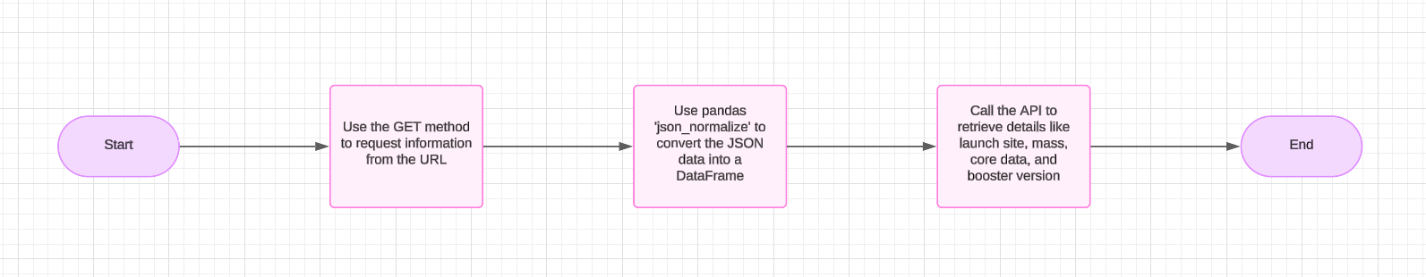
Data Collection – SpaceX API
I used the request get method to the url to get the information
Then used the pandas json_normalize to get the data into a dataframe
The given methods called the api tho get the launchsite, mass, coredata, boosterversion…
https://github.com/MonserrateRiera/DataScience_ProjectCapstone/blob/main/jupyter-labs-spacex-data-collection-api.ipynb
Place your flowchart of SpaceX API calls here

Slide 9

Data Collection - Scraping
Access to Wikipedia page with get method from request library
Create a Soup object with beautiful soup library
Get all the tables
Find the data table
Create a dataframe parsing the table information
https://github.com/MonserrateRiera/DataScience_ProjectCapstone/blob/main/jupyter-labs-webscraping.ipynb

Slide 10

Data Wrangling
The first was calculate the percentage of missing values and the column types. Then, calculate the number of launches on each site, number and occurrence of each orbit. Then we assigned to each row a new column named landing class, which value is 1 if is was successful and 0 if not.
https://github.com/MonserrateRiera/DataScience_ProjectCapstone/blob/main/labs-jupyter-spacex-Data%20wrangling.ipynb

Slide 11
EDA with Data Visualization
Scatterplot - FlightNumber and PayloadMass classified by success. The objective of this visualization was see the flights that was a success and their payloadmass.
Scatterplot- FlightNumber and Launchsite classified by success. This way we can easily see which flightnumber was a success or a failure depending on their launchsite.
Scatterplot- Payload Mass and Launch Site classified by success. We can see the relation between success and the payload and launch site.
Scatterplot - FlightNumber and Orbit type classified by success. We can know which flights was a success in that orbit type.
Payload Mass and Orbit type classified by success. We can see the relation between the payload and the orbit in and the success.
https://github.com/MonserrateRiera/DataScience_ProjectCapstone/blob/main/edadataviz.ipynb

Slide 12
EDA with SQL
sql select Launch_Site from SPACEXTABLE group by (Launch_Site)
%sql select * from SPACEXTABLE where Launch_Site Like 'CCA%' limit 5
%sql select sum(PAYLOAD_MASS__KG_) from SPACEXTABLE where Customer = 'NASA (CRS)’
%sql select Avg(PAYLOAD_MASS__KG_) from SPACEXTABLE where Booster_Version = 'F9 v1.1’
%sql select min(Date) from SPACEXTABLE where Landing_Outcome Like "Success%“
%sql select Booster_Version from SPACEXTABLE where Landing_Outcome = "Success (drone ship)" and PAYLOAD_MASS__KG_ < 6000 and PAYLOAD_MASS__KG_ > 4000
%sql select sum() from SPACEXTABLE where Landing_Outcome = "Success (drone ship)" and PAYLOAD_MASS__KG_ < 6000 and PAYLOAD_MASS__KG_ > 4000
%sql select Booster_Version from SPACEXTABLE where PAYLOAD_MASS__KG_ = (select max(PAYLOAD_MASS__KG_) from SPACEXTABLE)
%sql SELECT landing_outcome, COUNT(*) AS outcome_count FROM SPACEXTABLE WHERE Date BETWEEN '2010-06-04' AND '2017-03-20' GROUP BY landing_outcome ORDER BY outcome_count DESC;
https://github.com/MonserrateRiera/DataScience_ProjectCapstone/blob/main/jupyter-labs-eda-sql-coursera_sqllite.ipynb

Slide 13
Build an Interactive Map with Folium
A marker for each launch, marking them in green if they were a success or red if not. A circle in every launch site, a line between the launch site and the sea, and to the nearest city, ocean, railway and highway
To analyze the location of every launch site and why are there: far away from the city (to avoid accidents), near from the ocean(if there’s an emergency and needs landing there) and having a good communication with highway and trains to make easy get materials and workers.
https://github.com/MonserrateRiera/DataScience_ProjectCapstone/blob/main/lab_jupyter_launch_site_location.ipynb

Slide 14
Build a Dashboard with Plotly Dash
I did a piechart with the launchs per site, and if I select a site, a pie chart with success/fail rate for each one. In addition there’s a scatter plot with the relation payload and success, filtered by sites and payload mass slider.
This way we can see the total of lauches, and see in which site the most of the lauches was a success or failure. Also we can see the relation between payload and success. The interaction is needed to filter.
https://github.com/MonserrateRiera/DataScience_ProjectCapstone/blob/main/spacex_dash_app.py

Slide 15
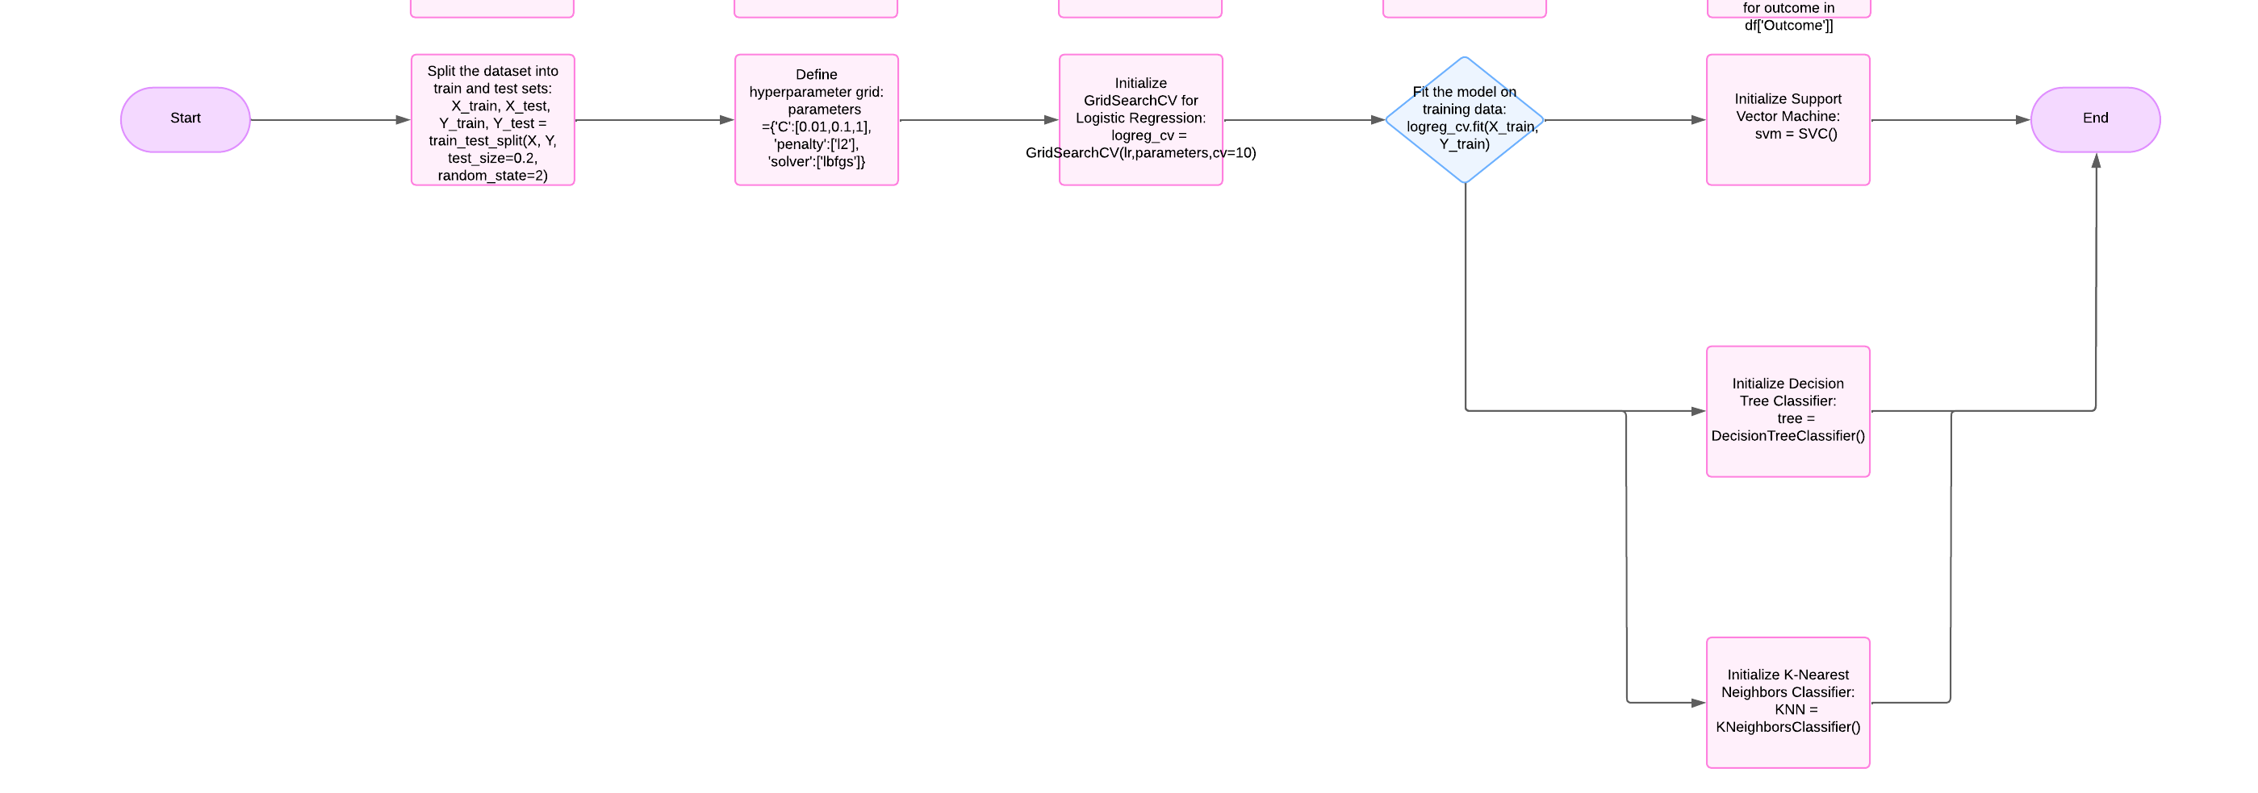
Predictive Analysis (Classification)
I was trying every method and I choosed the one with more accuracy.
https://github.com/MonserrateRiera/DataScience_ProjectCapstone/blob/main/SpaceX_Machine%20Learning%20Prediction_Part_5.ipynb

Slide 16
Results
Exploratory data analysis results
Interactive analytics demo in screenshots
Predictive analysis results

Slide 17

Section 2

Slide 18
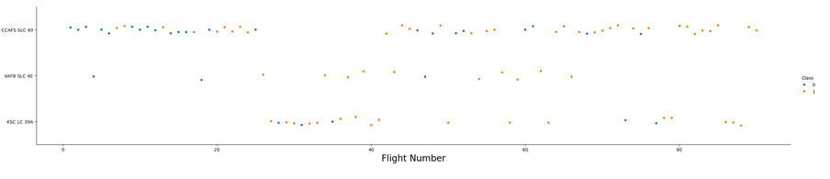
Flight Number vs. Launch Site

Slide 19
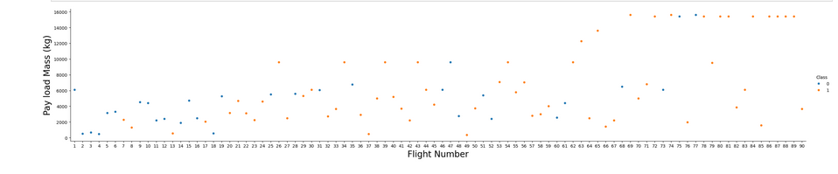
Payload vs. Launch Site

Slide 20
Success Rate vs. Orbit Type
Show a bar chart for the success rate of each orbit type
Show the screenshot of the scatter plot with explanations

Slide 21
Flight Number vs. Orbit Type

Slide 22
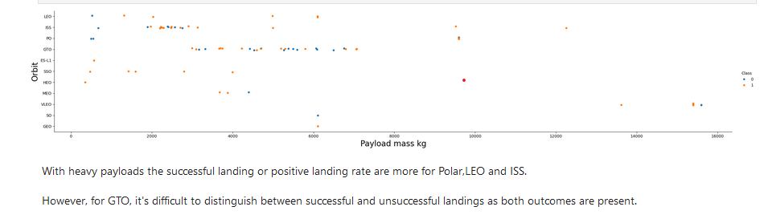
Payload vs. Orbit Type

Slide 23
Launch Success Yearly Trend
Show a line chart of yearly average success rate
Show the screenshot of the scatter plot with explanations

Slide 24
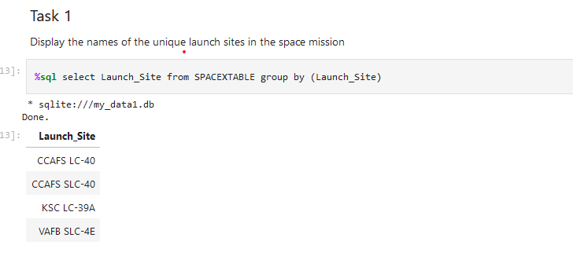
All Launch Site Names

Slide 25
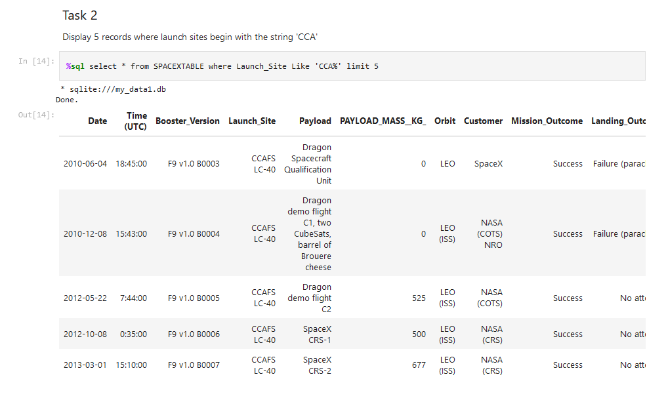
Launch Site Names Begin with 'CCA'

Slide 26
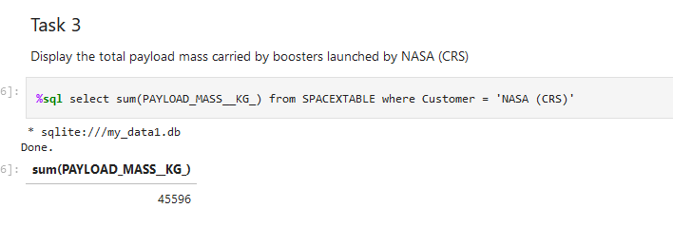
Total Payload Mass

Slide 27
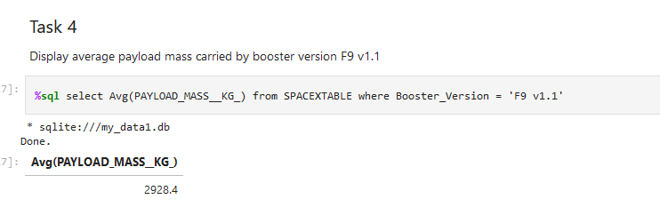
Average Payload Mass by F9 v1.1

Slide 28
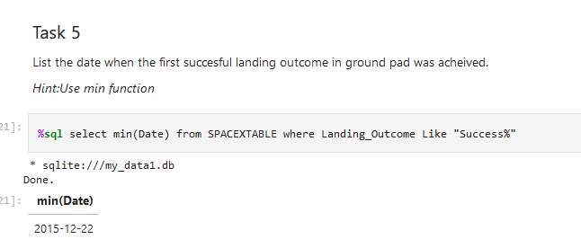
First Successful Ground Landing Date

Slide 29
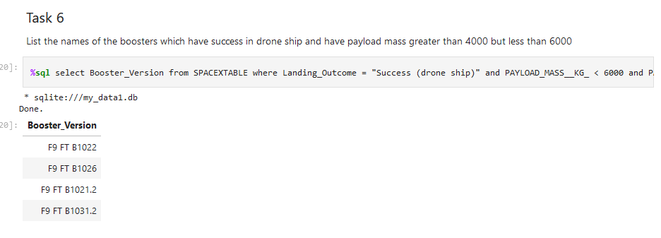
Successful Drone Ship Landing with Payload between 4000 and 6000

Slide 30
Total Number of Successful and Failure Mission Outcomes
Calculate the total number of successful and failure mission outcomes
Present your query result with a short explanation here

Slide 31
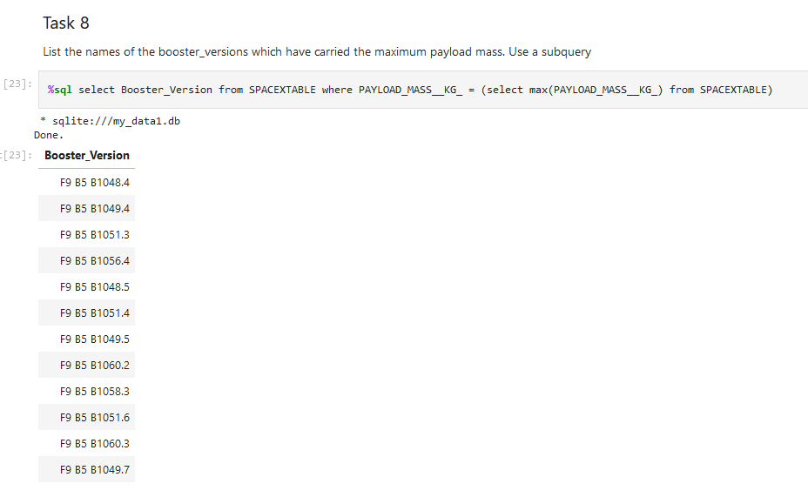
Boosters Carried Maximum Payload

Slide 32
2015 Launch Records
List the failed landing_outcomes in drone ship, their booster versions, and launch site names for in year 2015
Present your query result with a short explanation here

Slide 33
Rank Landing Outcomes Between 2010-06-04 and 2017-03-20
Rank the count of landing outcomes (such as Failure (drone ship) or Success (ground pad)) between the date 2010-06-04 and 2017-03-20, in descending order
Present your query result with a short explanation here

Slide 34

Section 3

Slide 35
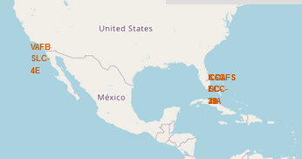
Launch sites location
All the launch sites are concentratd in two regions.

Slide 36
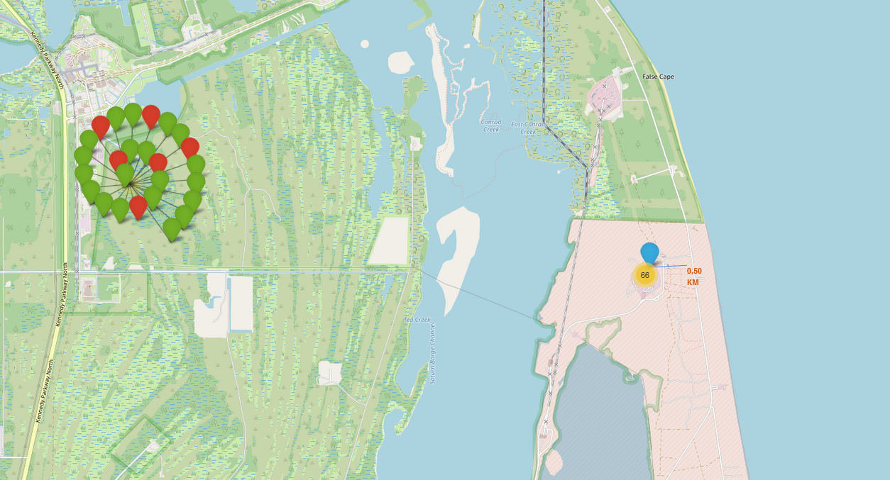
<successful rate>
Replace <Folium map screenshot 2> title with an appropriate title
Explore the folium map and make a proper screenshot to show the color-labeled launch outcomes on the map
Explain the important elements and findings on the screenshot

Slide 37
<Folium Map Screenshot 3>
Replace <Folium map screenshot 3> title with an appropriate title
Explore the generated folium map and show the screenshot of a selected launch site to its proximities such as railway, highway, coastline, with distance calculated and displayed
Explain the important elements and findings on the screenshot

Slide 38

Section 4

Slide 39
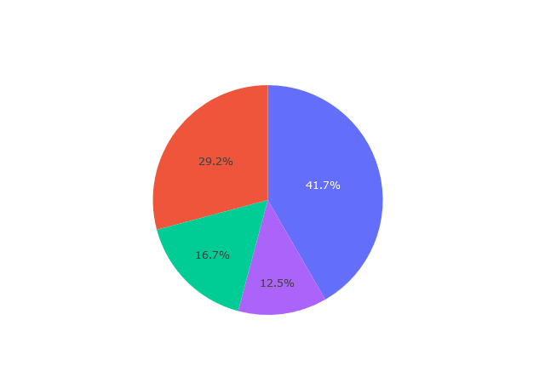
All sites pie chart
The most of the successful launches was made in KSC LC 39-A

Slide 40
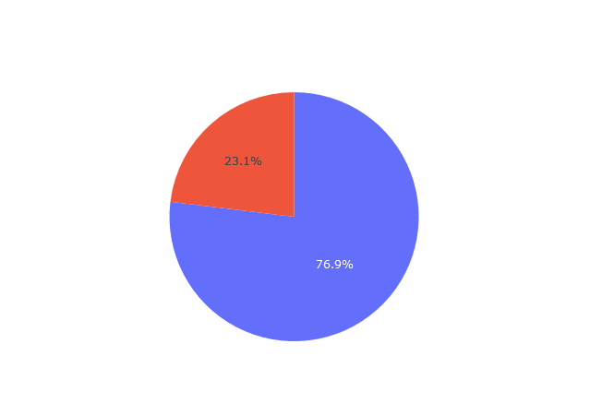
Place with most successful ratio
A 76.9% of launches was successful in KSC LC-39A

Slide 41
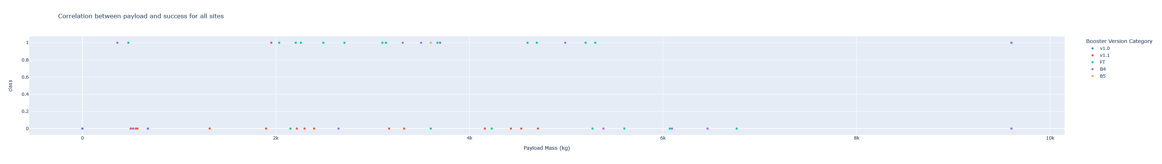
Payload and success
We can see the relation between payload and success.

Slide 42

Section 5

Slide 43
Classification Accuracy
Visualize the built model accuracy for all built classification models, in a bar chart
Find which model has the highest classification accuracy

Slide 44
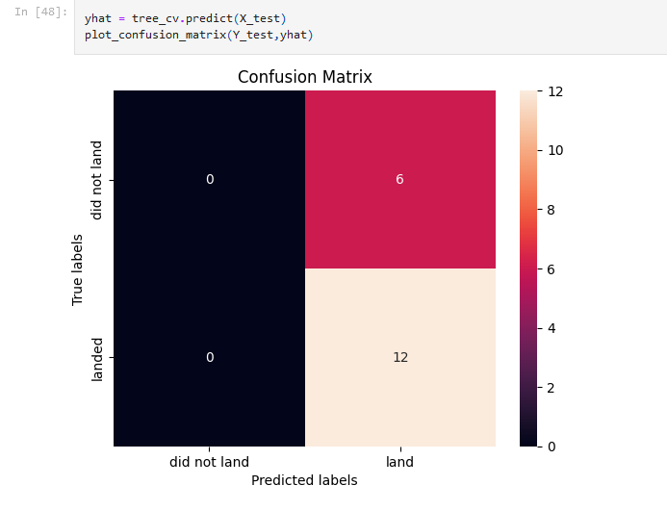
Confusion Matrix
The decision tree has the best confusion matrix, because it predicted

Slide 45
Conclusions
In conclusion:
Payload has a big impact in the successful rate
Launch site has a big impact in the successful rate
The location of launch sites are not in a random places
The tree decision has the best accuracy in the predictive model

Slide 46
Appendix
Include any relevant assets like Python code snippets, SQL queries, charts, Notebook outputs, or data sets that you may have created during this project

Slide 47


